Slide 1

Not just the 18th letter of the alphabet.

Slide 2
Learning Objectives
Use the R environment to create, save, and run simple scripts for data analysis
Identify resources online (and elsewhere) for future reference
Examine and correct scripts for errors and inefficiencies

Slide 3
Why use R? (adapted from Dr. Brewer’s Geog 6000 Course Materials)
R is the highest paid IT skill (Dice.com survey, January 2014)
R is #5 on list of most popular analytics jobs (Indeed.com, Feb.2014)
R most-used data science language after SQL (O’Reilly survey, January 2014)
R is used by 70% of data miners (Rexer survey, October 2013)
R growing faster than any other data science language (KDNuggets survey, August 2013)
R has more than 2 million users worldwide (Oracle estimate, February 2012)
Use of R in data analysis is growing, while use of SAS products are declining

Slide 4
Using Scripts
Editing and debugging
You may still find the console useful some cases!
Repetitive analysis
Sharing

Slide 5
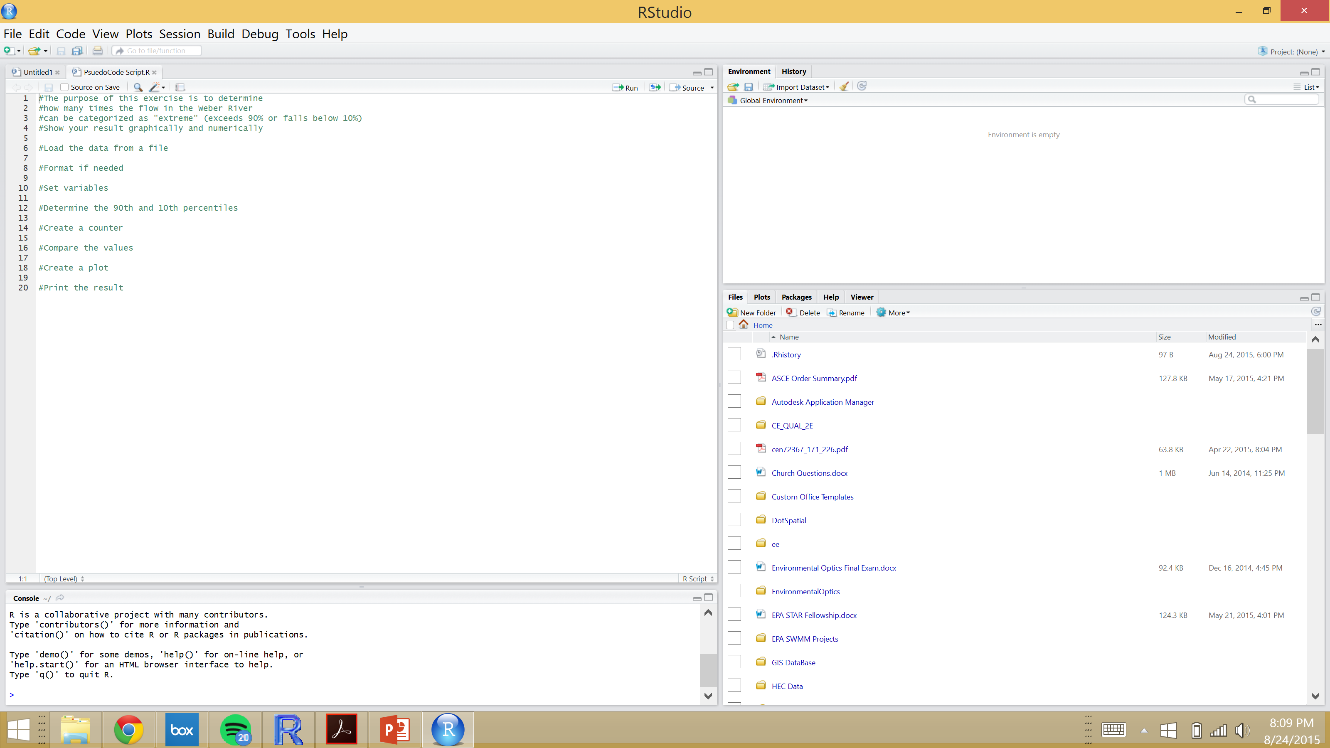
RStudio
www.rstudio.com

Slide 6
Hello World Script
Make sure R is installed correctly
Review basic programming techniques (if statements, printing results, etc)
Identify resources and references
Google
Stack Overflow
R Reference Card
Other resources from Pre-class Exercise

Slide 7
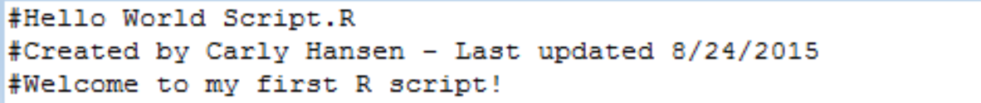
Hello World Script
#Print a welcome statement to the console
welcomeStatement <-"Hello World!"
print(welcomeStatement)
#Create a vector consisting of 40 numbers between 0-100 using the sample function, and print the result
data1 <-sample(0:100,40)
print(data1)

Slide 8
#Create a second simple vector of 50 random numbers from 0-100 using the runif function, and print the result
data2 <-runif(50,0,100)
print(data2)
#Construct an if statement on the board
#Compare the lengths of the two vectors. Print a result of the comparison using an if statement
if(length(data1)==length(data2)){
print("data1 is equal in length to data2")
} else {
print("data1 is not equal in length to data2")
}

Slide 9
#Compare the lengths of the two vectors. Print the result using an if statement and the sprintf function and %d notation to report how many items are in each vector
if(length(data1)==length(data2)){
sprintf("data1 is equal in length to data2, and both are length= %d",length(data1))
} else {
sprintf("data1 is not equal in length to data2. Length of data1 = %d and length of data 2 = %d", length(data1),length(data2))
}

Slide 10
Psuedo Code
The purpose of this exercise is to determine the distribution of monthly discharge and the number of extreme* monthly flow events in the Jordan River.
*exceeds 95% or falls below 5%
Show your result graphically and numerically.
Notes:
Divide into pairs to work on Pseudo Code, 3 minutes, put on board.
Coding Challenge – 10 minutes to complete script
Show on screen and explain – 5 minutes

Slide 11
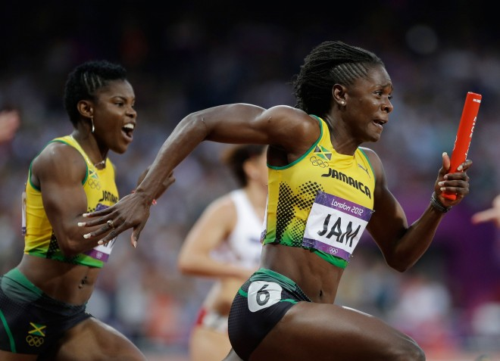
Relays
Notes:
3 teams of 5
One team per row in Layton
Setup one of their laptops at end of row, instructor laptop on screen with buggy code
Relay starts – 30 seconds per person on computer
First team to finish wins
Instructor shows correct code

